Slide 1
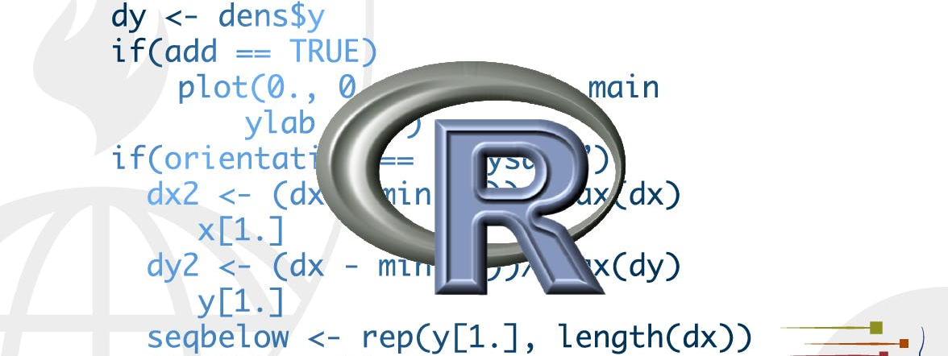
Data import
STA 4233 Introduction to Programming and Data Management in R
Notes:
Working with data provided by R packages is a great way to learn the tools of data science, but at some point you want to stop learning and start working with your own data. In this lecture, you’ll learn how to read plain-text rectangular files into R. Here, we’ll only scratch the surface of data import, but many of the principles will translate to other forms of data. We’ll finish with a few pointers to packages that are useful for other types of data.

Slide 2
Getting started
function | reads
read_csv() | comma delimited files
read_csv2() | semicolon separated files
read_tsv() | tab delimited files
read_delim() | files with any delimiter
read_fwf() | fixed width files
read_table() | files where columns are separated by white space
read_log() | Apache style log files
Notes:
Most of readr’s functions are concerned with turning flat files into data frames:
read_csv() reads comma delimited files, read_csv2() reads semicolon separated files (common in countries where , is used as the decimal place), read_tsv() reads tab delimited files, and read_delim() reads in files with any delimiter.
read_fwf() reads fixed width files. You can specify fields either by their widths with fwf_widths() or their position with fwf_positions(). read_table() reads a common variation of fixed width files where columns are separated by white space.
read_log() reads Apache style log files. (But also check out webreadr which is built on top of read_log() and provides many more helpful tools.)
These functions all have similar syntax: once you’ve mastered one, you can use the others with ease. For the rest of this chapter we’ll focus on read_csv(). Not only are csv files one of the most common forms of data storage, but once you understand read_csv(), you can easily apply your knowledge to all the other functions in readr.

Slide 3
Read_csv()
heights <- read_csv("data/heights.csv")
#> Parsed with column specification:
#> cols(
#> earn = col_double(),
#> height = col_double(),
#> sex = col_character(),
#> ed = col_double(),
#> age = col_double(),
#> race = col_character()
#> )
Notes:
The first argument to read_csv() is the most important: it’s the path to the file to read.
When you run read_csv() it prints out a column specification that gives the name and type of each column. That’s an important part of readr, which we’ll come back to in parsing a file.

Slide 4
Read_csv()
read_csv("a,b,c
1,2,3
4,5,6")
#> # A tibble: 2 x 3
#> a b c
#> <dbl> <dbl> <dbl>
#> 1 1 2 3
#> 2 4 5 6
Notes:
You can also supply an inline csv file. This is useful for experimenting with readr and for creating reproducible examples to share with others:
In both cases read_csv() uses the first line of the data for the column names, which is a very common convention. There are two cases where you might want to tweak this behaviour:

Slide 5
Skip= and comment=
read_csv("The first line of metadata
The second line of metadata
x,y,z
1,2,3", skip = 2)
#> # A tibble: 1 x 3
#> x y z
#> <dbl> <dbl> <dbl>
#> 1 1 2 3
read_csv("# A comment I want to skip
x,y,z
1,2,3", comment = "#")
#> # A tibble: 1 x 3
#> x y z
#> <dbl> <dbl> <dbl>
#> 1 1 2 3
Notes:
Sometimes there are a few lines of metadata at the top of the file. You can use skip = n to skip the first n lines; or use comment = "#" to drop all lines that start with (e.g.) #.

Slide 6
col_names =
read_csv("1,2,3\n4,5,6", col_names = FALSE)
#> # A tibble: 2 x 3
#> X1 X2 X3
#> <dbl> <dbl> <dbl>
#> 1 1 2 3
#> 2 4 5 6
read_csv("1,2,3\n4,5,6", col_names = c("x", "y", "z"))
#> # A tibble: 2 x 3
#> x y z
#> <dbl> <dbl> <dbl>
#> 1 1 2 3
#> 2 4 5 6
Notes:
The data might not have column names. You can use col_names = FALSE to tell read_csv() not to treat the first row as headings, and instead label them sequentially from X1 to Xn:
("\n" is a convenient shortcut for adding a new line. You’ll learn more about it and other types of string escape in string basics.)
Alternatively you can pass col_names a character vector which will be used as the column names:

Slide 7
Na=
read_csv("a,b,c\n1,2,.", na = ".")
#> # A tibble: 1 x 3
#> a b c
#> <dbl> <dbl> <lgl>
#> 1 1 2 NA
Notes:
Another option that commonly needs tweaking is na: this specifies the value (or values) that are used to represent missing values in your file:
This is all you need to know to read ~75% of CSV files that you’ll encounter in practice. You can also easily adapt what you’ve learned to read tab separated files with read_tsv() and fixed width files with read_fwf(). To read in more challenging files, you’ll need to learn more about how readr parses each column, turning them into R vectors.

Slide 8

Compared to base R
Why not read.csv()?
readr functions are
~10X faster
They produce tibbles
More reproducible
Notes:
If you’ve used R before, you might wonder why we’re not using read.csv(). There are a few good reasons to favor readr functions over the base equivalents:
They are typically much faster (~10x) than their base equivalents. Long running jobs have a progress bar, so you can see what’s happening. If you’re looking for raw speed, try data.table::fread(). It doesn’t fit quite so well into the tidyverse, but it can be quite a bit faster.
They produce tibbles, they don’t convert character vectors to factors, use row names, or munge the column names. These are common sources of frustration with the base R functions.
They are more reproducible. Base R functions inherit some behavior from your operating system and environment variables, so import code that works on your computer might not work on someone else’s.

Slide 9
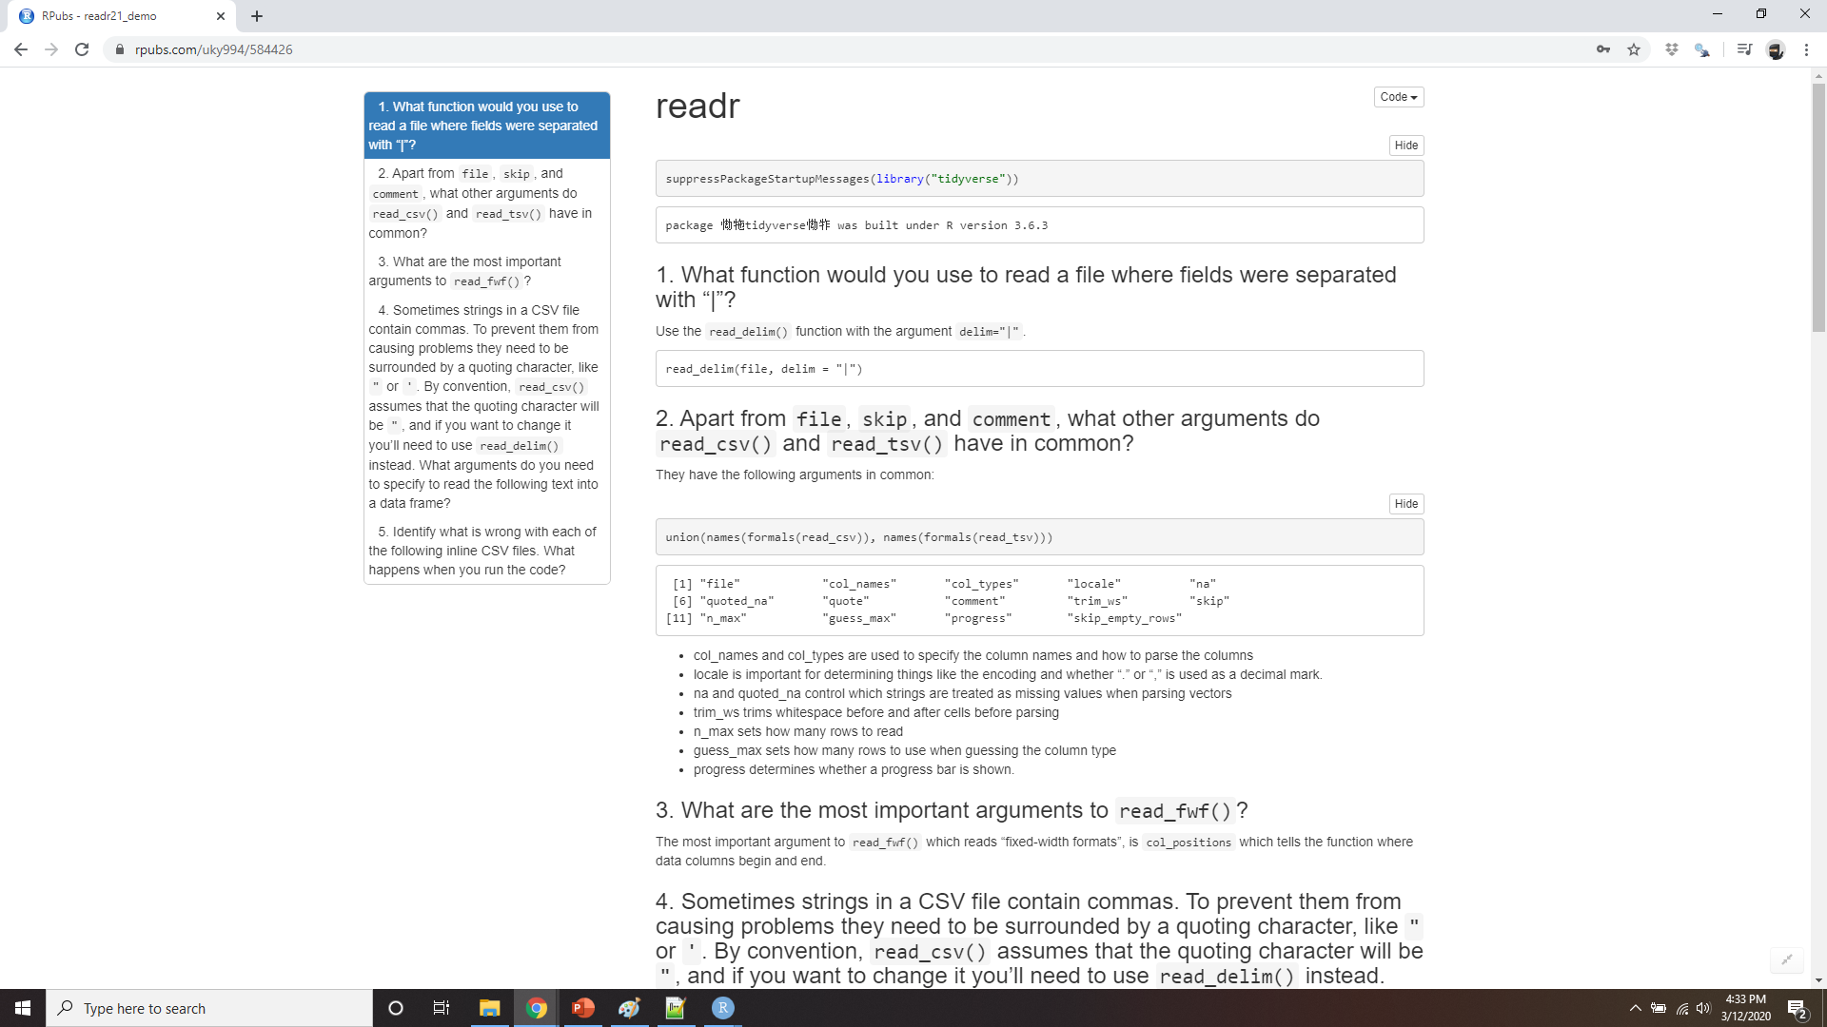
DEMO READR
Notes:
https://rpubs.com/uky994/584426
What function would you use to read a file where fields were separated with “|”?
Apart from file, skip, and comment, what other arguments do read_csv() and read_tsv() have in common?
What are the most important arguments to read_fwf()?
Sometimes strings in a CSV file contain commas. To prevent them from causing problems they need to be surrounded by a quoting character, like " or '. By default, read_csv() assumes that the quoting character will be ". What argument to read_csv() do you need to specify to read the following text into a data frame?
"x,y\n1,'a,b’”
5. Identify what is wrong with each of the following inline CSV files. What happens
when you run the code?
read_csv("a,b\n1,2,3\n4,5,6")
read_csv("a,b,c\n1,2\n1,2,3,4")
read_csv("a,b\n\"1")
read_csv("a,b\n1,2\na,b")
read_csv("a;b\n1;3")

Slide 10
Parsing a vector
str(parse_logical(c("TRUE", "FALSE", "NA")))
#> logi [1:3] TRUE FALSE NA
str(parse_integer(c("1", "2", "3")))
#> int [1:3] 1 2 3
str(parse_date(c("2010-01-01", "1979-10-14")))
#> Date[1:2], format: "2010-01-01" "1979-10-14"
Notes:
Before we get into the details of how readr reads files from disk, we need to take a little detour to talk about the parse_*() functions. These functions take a character vector and return a more specialized vector like a logical, integer, or date:
These functions are useful in their own right, but are also an important building block for readr. Once you’ve learned how the individual parsers work in this section, we’ll circle back and see how they fit together to parse a complete file in the next section.

Slide 11
Parsing a vector
parse_integer(c("1", "231", ".", "456"), na = ".")
#> [1] 1 231 NA 456
If parsing fails, you’ll get a warning
x <- parse_integer(c("123", "345", "abc", "123.45"))
#> Warning: 2 parsing failures.
#> row col expected actual
#> 3 -- an integer abc
#> 4 -- no trailing characters .45
Notes:
Like all functions in the tidyverse, the parse_*() functions are uniform: the first argument is a character vector to parse, and the na argument specifies which strings should be treated as missing:
If parsing fails, you’ll get a warning:
And the failures will be missing in the output:

Slide 12
Parsing a vector
And the failures will be missing in the output
x
#> [1] 123 345 NA NA
#> attr(,"problems")
#> # A tibble: 2 x 4
#> row col expected actual
#> <int> <int> <chr> <chr>
#> 1 3 NA an integer abc
#> 2 4 NA no trailing characters .45
problems(x)
Notes:
If there are many parsing failures, you’ll need to use problems() to get the complete set. This returns a tibble, which you can then manipulate with dplyr.

Slide 13
Important parsers
parse_logical() and parse_integer() parse logicals and integers respectively.
parse_double() is a strict numeric parser, and parse_number() is a flexible numeric parser.
parse_character() seems so simple that it shouldn’t be necessary.
parse_factor() create factors
parse_datetime(), parse_date(), and parse_time() allow you to parse various date & time specifications.
Notes:
Using parsers is mostly a matter of understanding what’s available and how they deal with different types of input. There are eight particularly important parsers:
parse_logical() and parse_integer() parse logicals and integers respectively. There’s basically nothing that can go wrong with these parsers so I won’t describe them here further.
parse_double() is a strict numeric parser, and parse_number() is a flexible numeric parser. These are more complicated than you might expect because different parts of the world write numbers in different ways.
parse_character() seems so simple that it shouldn’t be necessary. But one complication makes it quite important: character encodings.
parse_factor() create factors, the data structure that R uses to represent categorical variables with fixed and known values.
parse_datetime(), parse_date(), and parse_time() allow you to parse various date & time specifications. These are the most complicated because there are so many different ways of writing dates.
The following sections describe these parsers in more detail.

Slide 14
Numbers
People write numbers differently in different parts of the world.
Numbers are often surrounded by other characters that provide some context, like “$1000” or “10%”.
Numbers often contain “grouping” characters to make them easier to read, like “1,000,000”
Notes:
It seems like it should be straightforward to parse a number, but three problems make it tricky:
People write numbers differently in different parts of the world. For example, some countries use . in between the integer and fractional parts of a real number, while others use ,.
Numbers are often surrounded by other characters that provide some context, like “$1000” or “10%”.
Numbers often contain “grouping” characters to make them easier to read, like “1,000,000”, and these grouping characters vary around the world.

Slide 15
writing numbers differently
1
parse_double("1.23")
#> [1] 1.23
parse_double("1,23", locale = locale(decimal_mark = ","))
#> [1] 1.23
Notes:
To address the first problem, readr has the notion of a “locale”, an object that specifies parsing options that differ from place to place. When parsing numbers, the most important option is the character you use for the decimal mark. You can override the default value of . by creating a new locale and setting the decimal_mark argument:
readr’s default locale is US-centric, because generally R is US-centric (i.e. the documentation of base R is written in American English). An alternative approach would be to try and guess the defaults from your operating system. This is hard to do well, and, more importantly, makes your code fragile: even if it works on your computer, it might fail when you email it to a colleague in another country.

Slide 16
Numbers surrounded by other characters
2
parse_number("$100")
#> [1] 100
parse_number("20%")
#> [1] 20
parse_number("It cost $123.45")
#> [1] 123
Notes:
parse_number() addresses the second problem: it ignores non-numeric characters before and after the number. This is particularly useful for currencies and percentages, but also works to extract numbers embedded in text.

Slide 17
Numbers with “grouping” characters
# Used in America
parse_number("$123,456,789")
#> [1] 1.23e+08
# Used in many parts of Europe
parse_number("123.456.789", locale = locale(grouping_mark = "."))
#> [1] 1.23e+08
# Used in Switzerland
parse_number("123'456'789", locale = locale(grouping_mark = “’”))
#> [1] 1.23e+08
Notes:
The final problem is addressed by the combination of parse_number() and the locale as parse_number() will ignore the “grouping mark”:

Slide 18
Strings
charToRaw("Joey")
#> [1] 4a 6f 65 79
Notes:
It seems like parse_character() should be really simple — it could just return its input. Unfortunately life isn’t so simple, as there are multiple ways to represent the same string. To understand what’s going on, we need to dive into the details of how computers represent strings. In R, we can get at the underlying representation of a string using charToRaw():
Each hexadecimal number represents a byte of information: 4a is J, 6f is o, and so on. The mapping from hexadecimal number to character is called the encoding, and in this case the encoding is called ASCII. ASCII does a great job of representing English characters, because it’s the American Standard Code for Information Interchange.
Things get more complicated for languages other than English. In the early days of computing there were many competing standards for encoding non-English characters, and to correctly interpret a string you needed to know both the values and the encoding. For example, two common encodings are Latin1 (aka ISO-8859-1, used for Western European languages) and Latin2 (aka ISO-8859-2, used for Eastern European languages). In Latin1, the byte b1 is “±”, but in Latin2, it’s “ą”! Fortunately, today there is one standard that is supported almost everywhere: UTF-8. UTF-8 can encode just about every character used by humans today, as well as many extra symbols (like emoji!).

Slide 19
Utf-8
x1 <- "El Ni\xf1o was particularly bad this year"
x2 <- "\x82\xb1\x82\xf1\x82\xc9\x82\xbf\x82\xcd"
x1
#> [1] "El Ni\xf1o was particularly bad this year"
x2
#> [1] "\x82\xb1\x82\xf1\x82ɂ\xbf\x82\xcd"
To fix the problem you need to specify the encoding in parse_character():
parse_character(x1, locale = locale(encoding = "Latin1"))
#> [1] "El Niño was particularly bad this year"
parse_character(x2, locale = locale(encoding = "Shift-JIS"))
#> [1] "こんにちは"
Notes:
readr uses UTF-8 everywhere: it assumes your data is UTF-8 encoded when you read it, and always uses it when writing. This is a good default, but will fail for data produced by older systems that don’t understand UTF-8. If this happens to you, your strings will look weird when you print them. Sometimes just one or two characters might be messed up; other times you’ll get complete gibberish. For example:

Slide 20
guess_encoding()
path to a file
guess_encoding(charToRaw(x1))
#> # A tibble: 2 x 2
#> encoding confidence
#> <chr> <dbl>
#> 1 ISO-8859-1 0.46
#> 2 ISO-8859-9 0.23
guess_encoding(charToRaw(x2))
#> # A tibble: 1 x 2
#> encoding confidence
#> <chr> <dbl>
#> 1 KOI8-R 0.42
http://kunststube.net/encoding/.
Notes:
How do you find the correct encoding? If you’re lucky, it’ll be included somewhere in the data documentation. Unfortunately, that’s rarely the case, so readr provides guess_encoding() to help you figure it out. It’s not foolproof, and it works better when you have lots of text (unlike here), but it’s a reasonable place to start. Expect to try a few different encodings before you find the right one.
The first argument to guess_encoding() can either be a path to a file, or, as in this case, a raw vector (useful if the strings are already in R).
Encodings are a rich and complex topic, and I’ve only scratched the surface here. If you’d like to learn more I’d recommend reading the detailed explanation at http://kunststube.net/encoding/.

Slide 21
Factors
fruit <- c("apple", "banana")
parse_factor(c("apple", "banana", "bananana"), levels = fruit)
#> Warning: 1 parsing failure.
#> row col expected actual
#> 3 -- value in level set bananana
#> [1] apple banana <NA>
#> attr(,"problems")
#> # A tibble: 1 x 4
#> row col expected actual
#> <int> <int> <chr> <chr>
#> 1 3 NA value in level set bananana
#> Levels: apple banana
Notes:
R uses factors to represent categorical variables that have a known set of possible values. Give parse_factor() a vector of known levels to generate a warning whenever an unexpected value is present:
But if you have many problematic entries, it’s often easier to leave as character vectors and then use the tools you’ll learn about in strings and factors to clean them up.

Slide 22
Dates, date-times, and times
parse_datetime() expects an ISO8601 date-time.
parse_datetime("2010-10-01T2010")
#> [1] "2010-10-01 20:10:00 UTC"
# If time is omitted, it will be set to midnight
parse_datetime("20101010")
#> [1] "2010-10-10 UTC"
https://en.wikipedia.org/wiki/ISO_8601
Notes:
You pick between three parsers depending on whether you want a date (the number of days since 1970-01-01), a date-time (the number of seconds since midnight 1970-01-01), or a time (the number of seconds since midnight). When called without any additional arguments:
ISO8601 is an international standard in which the components of a date are organized from biggest to smallest: year, month, day, hour, minute, second.
This is the most important date/time standard, and if you work with dates and times frequently, I recommend reading https://en.wikipedia.org/wiki/ISO_8601

Slide 23
Dates, date-times, and times
parse_date() expects a four digit year, a - or /, the month, a - or /, then the day:
parse_date("2010-10-01")
#> [1] "2010-10-01"
Notes:
parse_date() expects a four digit year, a - or /, the month, a - or /, then the day:

Slide 24
Dates, date-times, and times
parse_time() expects the hour, :, minutes, optionally : and seconds, and an optional am/pm specifier:
library(hms)
parse_time("01:10 am")
#> 01:10:00
parse_time("20:10:01")
#> 20:10:01
Notes:
parse_time() expects the hour, :, minutes, optionally : and seconds, and an optional am/pm specifier:
Base R doesn’t have a great built in class for time data, so we use the one provided in the hms package.

Slide 25
Formatting dates
Year
%Y (4 digits).
%y (2 digits); 00-69 -> 2000-2069,
70-99 -> 1970-1999.
Month
%m (2 digits).
%b (abbreviated name, like “Jan”).
%B (full name, “January”).
Day
%d (2 digits).
%e (optional leading space).
Time
%H 0-23 hour.
%I 0-12, must be used with %p.
%p AM/PM indicator.
%M minutes.
%S integer seconds.
%OS real seconds.
%Z Time zone (as name, e.g. America/Chicago).
%z (as offset from UTC, e.g. +0800).
Non-digits
%. skips one non-digit character.
%* skips any number of non-digits.
Notes:
If these defaults don’t work for your data you can supply your own date-time format, built up of the following pieces:
Beware of abbreviations: if you’re American, note that “EST” is a Canadian time zone that does not have daylight savings time. It is not Eastern Standard Time!

Slide 26
Which format?
parse_date("01/02/15", "%m/%d/%y")
#> [1] "2015-01-02"
parse_date("01/02/15", "%d/%m/%y")
#> [1] "2015-02-01"
parse_date("01/02/15", "%y/%m/%d")
#> [1] "2001-02-15"
parse_date("1 janvier 2015", "%d %B %Y", locale = locale("fr"))
#> [1] "2015-01-01"
Notes:
The best way to figure out the correct format is to create a few examples in a character vector, and test with one of the parsing functions. For example:
If you’re using %b or %B with non-English month names, you’ll need to set the lang argument to locale(). See the list of built-in languages in date_names_langs(), or if your language is not already included, create your own with date_names().

Slide 27
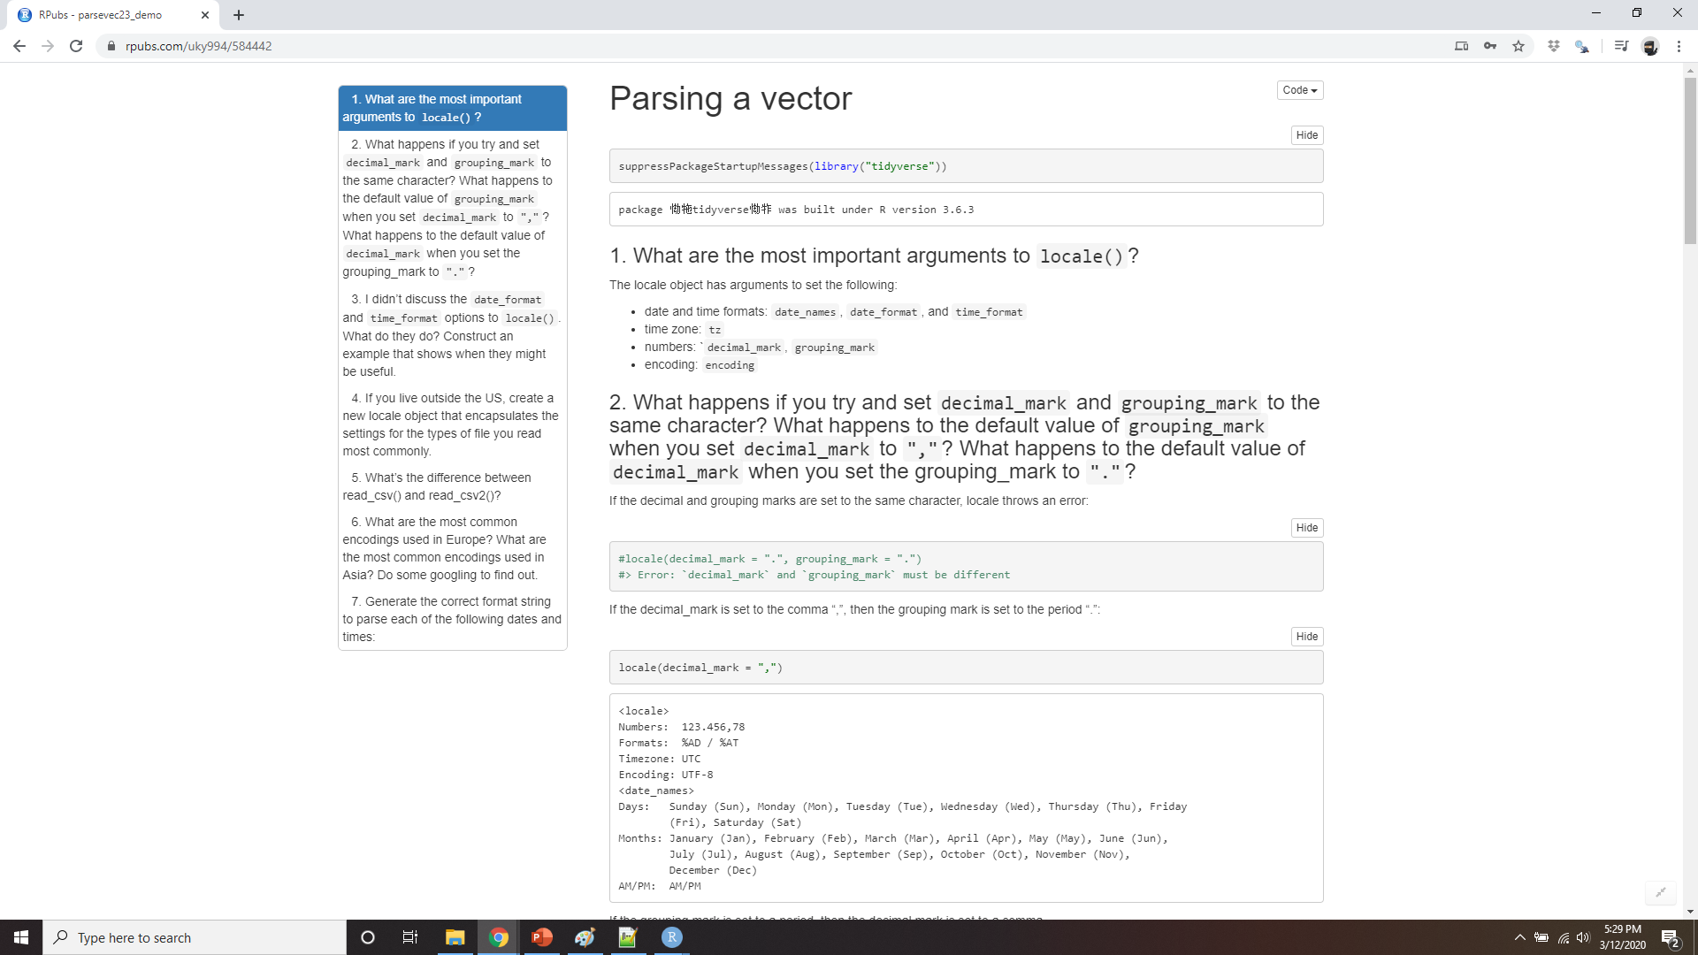
DEMO parsing a vector
Notes:
https://rpubs.com/uky994/584442
What are the most important arguments to locale()?
What happens if you try and set decimal_mark and grouping_mark to the same character? What happens to the default value of grouping_mark when you set decimal_mark to “,”? What happens to the default value of decimal_mark when you set the grouping_mark to “.”?
I didn’t discuss the date_format and time_format options to locale(). What do they do? Construct an example that shows when they might be useful.
If you live outside the US, create a new locale object that encapsulates the settings for the types of file you read most commonly.
What’s the difference between read_csv() and read_csv2()?
What are the most common encodings used in Europe? What are the most common encodings used in Asia? Do some googling to find out.
Generate the correct format string to parse each of the following dates and times:
d1 <- "January 1, 2010" d2 <- "2015-Mar-07" d3 <- "06-Jun-2017" d4 <- c("August 19 (2015)", "July 1 (2015)") d5 <- "12/30/14" # Dec 30, 2014 t1 <- "1705" t2 <- "11:15:10.12 PM"

Slide 28
Parsing a file
How readr automatically guesses the type of each column.
How to override the default specification.
Notes:
Now that you’ve learned how to parse an individual vector, it’s time to return to the beginning and explore how readr parses a file. There are two new things that you’ll learn about in this section:

Slide 29
Strategy
guess_parser("2010-10-01")
#> [1] "date"
guess_parser("15:01")
#> [1] "time"
guess_parser(c("TRUE", "FALSE"))
#> [1] "logical"
guess_parser(c("1", "5", "9"))
#> [1] "double"
guess_parser(c("12,352,561"))
#> [1] "number"
str(parse_guess("2010-10-10"))
#> Date[1:1], format: "2010-10-10"
Notes:
readr uses a heuristic to figure out the type of each column: it reads the first 1000 rows and uses some (moderately conservative) heuristics to figure out the type of each column. You can emulate this process with a character vector using guess_parser(), which returns readr’s best guess, and parse_guess() which uses that guess to parse the column:

Slide 30
Strategy
Try each of the types, stop when it finds a match:
logical: contains only “F”, “T”, “FALSE”, or “TRUE”.
integer: contains only numeric characters (and -).
double: contains only valid doubles (including numbers like 4.5e-5).
number: contains valid doubles with the grouping mark inside.
time: matches the default time_format.
date: matches the default date_format.
date-time: any ISO8601 date.
If none of these rules apply, then the column will stay as a vector of strings.
Notes:
The heuristic tries each of the following types, stopping when it finds a match:
logical: contains only “F”, “T”, “FALSE”, or “TRUE”.
integer: contains only numeric characters (and -).
double: contains only valid doubles (including numbers like 4.5e-5).
number: contains valid doubles with the grouping mark inside.
time: matches the default time_format.
date: matches the default date_format.
date-time: any ISO8601 date.
If none of these rules apply, then the column will stay as a vector of strings.

Slide 31
Problems
Doesn’t always work for larger files:
The first thousand rows might be a special case
The column might contain a lot of missing values.
Notes:
These defaults don’t always work for larger files. There are two basic problems:
The first thousand rows might be a special case, and readr guesses a type that is not sufficiently general. For example, you might have a column of doubles that only contains integers in the first 1000 rows.
The column might contain a lot of missing values. If the first 1000 rows contain only NAs, readr will guess that it’s a logical vector, whereas you probably want to parse it as something more specific.

Slide 32
Problems
challenge <- read_csv(readr_example("challenge.csv"))
#> Parsed with column specification:
#> cols(
#> x = col_double(),
#> y = col_logical()
#> )
#> Warning: 1000 parsing failures.
#> row col expected actual file
#> 1001 y 1/0/T/F/TRUE/FALSE 2015-01-16 '/home/travis/R/Library/readr/extdata/challenge.csv'
#> 1002 y 1/0/T/F/TRUE/FALSE 2018-05-18 '/home/travis/R/Library/readr/extdata/challenge.csv'
#> 1003 y 1/0/T/F/TRUE/FALSE 2015-09-05 '/home/travis/R/Library/readr/extdata/challenge.csv'
#> 1004 y 1/0/T/F/TRUE/FALSE 2012-11-28 '/home/travis/R/Library/readr/extdata/challenge.csv'
#> 1005 y 1/0/T/F/TRUE/FALSE 2020-01-13 '/home/travis/R/Library/readr/extdata/challenge.csv'
#> .... ... .................. .......... ....................................................
#> See problems(...) for more details.
Notes:
readr contains a challenging CSV that illustrates both of these problems:
(Note the use of readr_example() which finds the path to one of the files included with the package)

Slide 33
Problems
problems(challenge)
#> # A tibble: 1,000 x 5
#> row col expected actual file
#> <int> <chr> <chr> <chr> <chr>
#> 1 1001 y 1/0/T/F/TRUE/FA… 2015-01-… '/home/travis/R/Library/readr/extdata/…
#> 2 1002 y 1/0/T/F/TRUE/FA… 2018-05-… '/home/travis/R/Library/readr/extdata/…
#> 3 1003 y 1/0/T/F/TRUE/FA… 2015-09-… '/home/travis/R/Library/readr/extdata/…
#> 4 1004 y 1/0/T/F/TRUE/FA… 2012-11-… '/home/travis/R/Library/readr/extdata/…
#> 5 1005 y 1/0/T/F/TRUE/FA… 2020-01-… '/home/travis/R/Library/readr/extdata/…
#> 6 1006 y 1/0/T/F/TRUE/FA… 2016-04-… '/home/travis/R/Library/readr/extdata/…
#> # … with 994 more rows
Notes:
There are two printed outputs: the column specification generated by looking at the first 1000 rows, and the first five parsing failures. It’s always a good idea to explicitly pull out the problems(), so you can explore them in more depth:

Slide 34
Problems
tail(challenge)
#> # A tibble: 6 x 2
#> x y
#> <dbl> <lgl>
#> 1 0.805 NA
#> 2 0.164 NA
#> 3 0.472 NA
#> 4 0.718 NA
#> 5 0.270 NA
#> 6 0.608 NA
Notes:
A good strategy is to work column by column until there are no problems remaining. Here we can see that there are a lot of parsing problems with the y column. If we look at the last few rows, you’ll see that they’re dates stored in a character vector:

Slide 35
Problems
challenge <- read_csv(
readr_example("challenge.csv"),
col_types = cols(
x = col_double(),
y = col_logical()
)
)
Notes:
That suggests we need to use a date parser instead. To fix the call, start by copying and pasting the column specification into your original call:

Slide 36
Problems
challenge <- read_csv(
readr_example("challenge.csv"),
col_types = cols(
x = col_double(),
y = col_date()
)
)
tail(challenge) #> # A tibble: 6 x 2
#> x y
#> <dbl> <date>
#> 1 0.805 2019-11-21
#> 2 0.164 2018-03-29
#> 3 0.472 2014-08-04
#> 4 0.718 2015-08-16
#> 5 0.270 2020-02-04
Notes:
Then you can fix the type of the y column by specifying that y is a date column:
Every parse_xyz() function has a corresponding col_xyz() function. You use parse_xyz() when the data is in a character vector in R already; you use col_xyz() when you want to tell readr how to load the data.
I highly recommend always supplying col_types, building up from the print-out provided by readr. This ensures that you have a consistent and reproducible data import script. If you rely on the default guesses and your data changes, readr will continue to read it in. If you want to be really strict, use stop_for_problems(): that will throw an error and stop your script if there are any parsing problems.

Slide 37
Other strategies
challenge2 <- read_csv(readr_example("challenge.csv"), guess_max = 1001)
#> Parsed with column specification:
#> cols(
#> x = col_double(),
#> y = col_date(format = "")
#> )
challenge2
#> # A tibble: 2,000 x 2
#> x y
#> <dbl> <date>
#> 1 404 NA
#> 2 4172 NA
#> 3 3004 NA
#> 4 787 NA
#> 5 37 NA
#> 6 2332 NA
#> # … with 1,994 more rows
Notes:
There are a few other general strategies to help you parse files:
In the previous example, we just got unlucky: if we look at just one more row than the default, we can correctly parse in one shot:

Slide 38
Other strategies
challenge2 <- read_csv(readr_example("challenge.csv"),
col_types = cols(.default = col_character())
)
Notes:
Sometimes it’s easier to diagnose problems if you just read in all the columns as character vectors:

Slide 39
Other strategies
# Note the column types
type_convert(df)
#> Parsed with column specification:
#> cols(
#> x = col_double(),
#> y = col_double()
#> )
#> # A tibble: 3 x 2
#> x y
#> <dbl> <dbl>
#> 1 1 1.21
#> 2 2 2.32
#> 3 3 4.56
df <- tribble(
~x, ~y,
"1", "1.21",
"2", "2.32",
"3", "4.56"
)
df
#> # A tibble: 3 x 2
#> x y
#> <chr> <chr>
#> 1 1 1.21
#> 2 2 2.32
#> 3 3 4.56
Notes:
This is particularly useful in conjunction with type_convert(), which applies the parsing heuristics to the character columns in a data frame.
If you’re reading a very large file, you might want to set n_max to a smallish number like 10,000 or 100,000. That will accelerate your iterations while you eliminate common problems.
If you’re having major parsing problems, sometimes it’s easier to just read into a character vector of lines with read_lines(), or even a character vector of length 1 with read_file(). Then you can use the string parsing skills you’ll learn later to parse more exotic formats.

Slide 40
Writing to a file
readr also comes with two useful functions for writing data back to disk: write_csv() and write_tsv().
Always encoding strings in UTF-8.
Saving dates and date-times in ISO8601 format so they are easily parsed elsewhere.
If you want to export a csv file to Excel, use write_excel_csv()
write_csv(challenge, "challenge.csv")
Notes:
readr also comes with two useful functions for writing data back to disk: write_csv() and write_tsv(). Both functions increase the chances of the output file being read back in correctly by:
Always encoding strings in UTF-8.
Saving dates and date-times in ISO8601 format so they are easily parsed elsewhere.
If you want to export a csv file to Excel, use write_excel_csv() — this writes a special character (a “byte order mark”) at the start of the file which tells Excel that you’re using the UTF-8 encoding.

Slide 41
Write_csv
challenge
#> # A tibble: 2,000 x 2
#> x y
#> <dbl> <date>
#> 1 404 NA
#> 2 4172 NA
#> 3 3004 NA
#> 4 787 NA
#> 5 37 NA
#> 6 2332 NA
#> # … with 1,994 more rows
write_csv(challenge, "challenge-2.csv")
read_csv("challenge-2.csv")
#> Parsed with column specification:
#> cols(
#> x = col_double(),
#> y = col_logical()
#> )
#> # A tibble: 2,000 x 2
#> x y
#> <dbl> <lgl>
#> 1 404 NA
#> 2 4172 NA
#> 3 3004 NA
#> 4 787 NA
#> 5 37 NA
#> 6 2332 NA
#> # … with 1,994 more rows
Notes:
Note that the type information is lost when you save to csv:

Slide 42
write_rds()and read_rds()
write_rds() and read_rds() use R’s custom binary format called RDS:
write_rds(challenge, "challenge.rds")
read_rds("challenge.rds")
#> # A tibble: 2,000 x 2
#> x y
#> <dbl> <date>
#> 1 404 NA
#> 2 4172 NA
#> 3 3004 NA
#> 4 787 NA
#> 5 37 NA
#> 6 2332 NA
#> # … with 1,994 more rows
Notes:
This makes CSVs a little unreliable for caching interim results—you need to recreate the column specification every time you load in. There are two alternatives:
write_rds() and read_rds() are uniform wrappers around the base functions readRDS() and saveRDS(). These store data in R’s custom binary format called RDS:

Slide 43
The feather package
library(feather)
write_feather(challenge, "challenge.feather")
read_feather("challenge.feather")
#> # A tibble: 2,000 x 2
#> x y
#> <dbl> <date>
#> 1 404 <NA>
#> 2 4172 <NA>
#> 3 3004 <NA>
#> 4 787 <NA>
#> 5 37 <NA>
#> 6 2332 <NA>
#> # ... with 1,994 more rows
Notes:
The feather package implements a fast binary file format that can be shared across programming languages:
Feather tends to be faster than RDS and is usable outside of R. RDS supports list-columns (which you’ll learn about in many models); feather currently does not.

Slide 44
Other types of data
haven reads SPSS, Stata, and SAS files.
readxl reads excel files (both .xls and .xlsx).
DBI, along with a database specific backend (e.g. RMySQL, RSQLite, RPostgreSQL etc) allows you to run SQL queries against a database and return a data frame.
For hierarchical data: use jsonlite (by Jeroen Ooms) for json, and xml2 for XML. Jenny Bryan has some excellent worked examples at https://jennybc.github.io/purrr-tutorial/.
For other file types, try the R data import/export manual and the rio package.
Notes:
To get other types of data into R, we recommend starting with the tidyverse packages listed below. They’re certainly not perfect, but they are a good place to start. For rectangular data:
For hierarchical data: use jsonlite (by Jeroen Ooms) for json, and xml2 for XML. Jenny Bryan has some excellent worked examples at https://jennybc.github.io/purrr-tutorial/.
For other file types, try the R data import/export manual and the rio package.

